Slide 1
How to Green the Sinai Peninsula
Sev Clarke, Envisionation.org
July 2021

Slide 2
Sinai Situation
The Egyptian Sinai is a desert region with a land area of 60,000km² and a sparse population of some 600,000
The Sinai is bordered to the north by the Mediterranean Sea and to the south by the Red Sea. To the east and west, much of its borders consist of narrow extensions of the Red Sea
The land is typically flat and sandy in the north and mountainous and rocky in the south. In the centre there appears to be the salt-encrusted remains of an extensive river system running northwards
The land would be suitable for agriculture, were it not for the virtual absence of rainfall and the limited availability of typically brackish, aquifer resources. Its potential productivity can be seen from the similar and immediately adjacent area watered by the Nile delta and by the partly vegetated, agricultural land in Israel to the northeast
Annual daytime temperatures in Sinai range from 23-38⁰C, night time ones 16-29⁰C. Humidity averages 43% in January and 23% in July – that is to say extremely dry
The prevailing winds are from the NNE at an average of 11kts
Egyptian territorial waters and EEZ extend some 370km north into the Mediterranean, though those of Israel somewhat reduce the northward extent of those in the east of Sinai to perhaps half this

Slide 3
The Greening Concept
Now, a 2.5MW Seatomiser (seawater atomizing) floating, offshore wind turbine installation (see separate presentation) is designed to deliver several capabilities:
To spray and evaporate seawater at rates of the order of a cubic metre per second, depending on wind speed;
To generate cooling fog, long-lived and solar-reflecting sea salt aerosols (SSA), and marine cloud;
To cool surface waters by solar reflection, such that coral reefs, seagrass meadows and marine animals are not stressed or killed by overheating
To reduce globally-warming atmospheric methane concentrations photo-catalytically; and
Beneficially to influence downwind precipitation and humidity by spraying carefully-sized droplets of seawater into the air such that they cause humidity and additional precipitation at calibrated distances far downwind
Most of the brine is made either to fall back into the sea before it reaches land, or else to remain airborne until its aerosols nucleate raindrops or ice particles a few to several days later – in the case of Sinai watering, probably somewhere in the Southern Ocean, the location being determined by weather forecasting and the controllable, modal size of the sprayed droplets
When such precipitation does occur, each tiny, nucleating particle would have absorbed so much atmospheric moisture as to render its resulting raindrop to consist of purer water than occurs in most rivers.

Slide 4
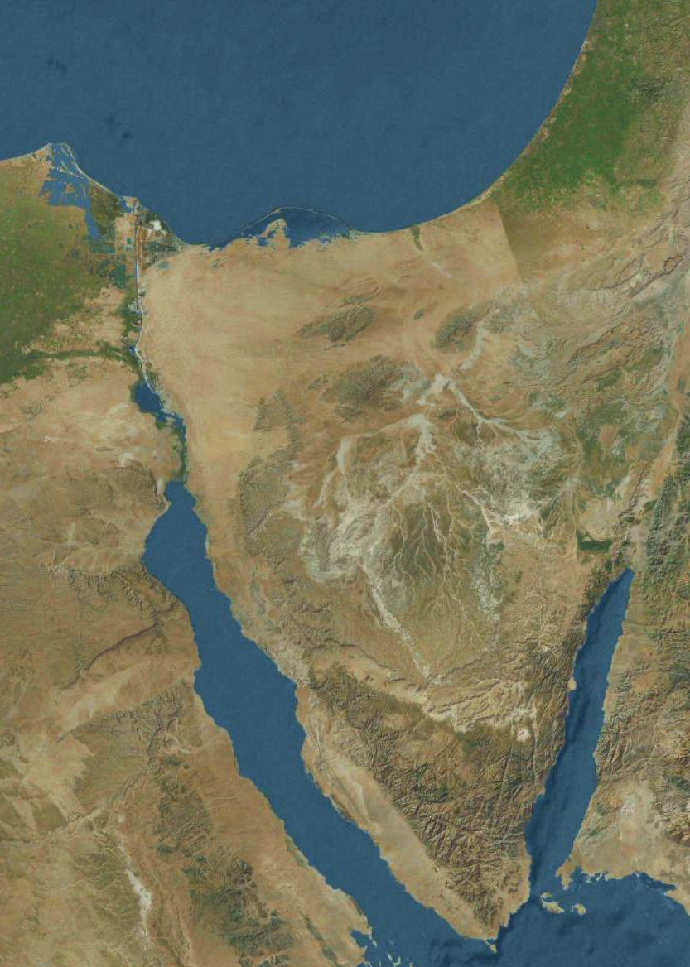
Prevailing
wind
Map of Sinai
Nile
delta
Egyptian-Israeli border
Red Sea

Slide 5
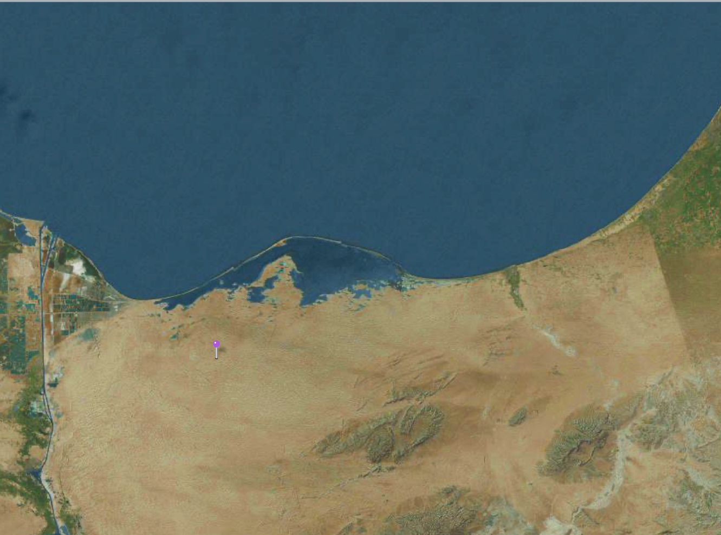
Egyptian waters
Israeli waters & EEZ
Seatomiser
Effects
Seatomiser Offshore Arrays
Sea fogs and marine cloud form
Brine drops out
Rain droplets start to form
Prevailing NNE Winds
Mists and rainfall
Invisible, long-lived SSAs continue to cool the overheated air and land

Slide 6
Seatomiser Layout
Some 2,000 Seatomisers might be positioned in two rows, one at 90km and one at 110km offshore along the ~130km EW N. Sinai coastline. Seatomiser towers in a row would thus be 130m apart. At >90km offshore, the Seatomisers should be virtually invisible from the shore and be unlikely to affect inshore fishing activity, except by partly shading and cooling the overheated surface waters and coral reefs.
As the rotor diameter of a 2.5MW wind turbine is ~120m, this would mean a gap of ~10m between the closest blade tips of adjacent Seatomisers. Gaps might be required for shipping routes and tourist vessels.
The outer row might have their hubs at, say, 110m height, the inner row at 160m, so that the cooled and moistened air from the outer row would sink below the lowest blade tip position of the inner row – thereby ensuring maximum evaporation from relatively dry air, whilst allowing both cooled plumes to warm up from ocean heat exchange before they hit land and therefore be more easily lofted upwards by terrestrial turbulence.
Each row might usefully be specialized, the outer one to generating the finest droplets, sea salt aerosols (SSA), marine cloud brightening, and iron salt aerosols (ISA) to reduce atmospheric methane; the inner one to generating sea fog and atmospheric water vapour. These changes should both lower the costs and increase the effectiveness of the Seatomiser system. They should also ensure there is minimal moisture scavenging by Coarse droplets generated by the outer row.
Now, the current price for a 2.5MW wind turbine is ~$3.25m. A deployed Seatomiser built from this (after development and at scale) might cost ~$5m in June 2021 US dollars, making the capital cost of Greening the Sinai for some 20 years using Seatomisers in the order of USD$10b.

